Slide 1

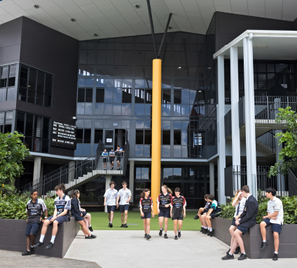
Year 7 2027
Information session
CARE COURTESY COOPERATION CHALLENGE COMMITMENT

Slide 2
Acknowledgement of Country
Chancellor State College acknowledges the Kabi Kabi Peoples, the traditional Custodians of the land on which our school is built and where we meet today.
We pay our respects to the Elders past and present, and acknowledge the important role First Nations people continue to play within our community.
CARE COURTESY COOPERATION CHALLENGE COMMITMENT

Slide 3
Vision & Values
Vision | To be ‘the best we can be’
This Vision is modelled through the College Core Values:
Care We value one another and our environment. We celebrate together and recognise health and wellbeing needs within our community.
Courtesy We respect and value our differences, ensuring we embrace an inclusive approach throughout our community.
Cooperation We create a common purpose through strong communication and collaboration across our community.
Commitment We are a community of learners focussed on continuous improvement in our journey of life-long learning.
Challenge We aspire to excellence in 21st Century teaching and learning to build life-long learners.

Slide 4
Junior Secondary
Years 7-9
We believe that the key to a successful Junior Secondary schooling experience lies in the strength of the partnership between the teacher, the student and home.
Support staff – Guidance officers, School nurse, Student Engagement staff, Year level coordinators.
Key teachers take great care, become familiar with their students through focused lessons and inquiry based investigations and projects.
CARE COURTESY COOPERATION CHALLENGE COMMITMENT

Slide 5

Curriculum
Students are supported to reach their potential through exposure to a range of immersive learning experiences and opportunities that ignite their talents, interests and passions.
These pathways prepare students for their next phase of learning.
CARE COURTESY COOPERATION CHALLENGE COMMITMENT

Slide 6

Leadership
Leadership opportunities exist for all students through our College Portfolios:
Creative Industries
Community
Environmental
Sport
STEM
Leo
CARE COURTESY COOPERATION CHALLENGE COMMITMENT

Slide 7
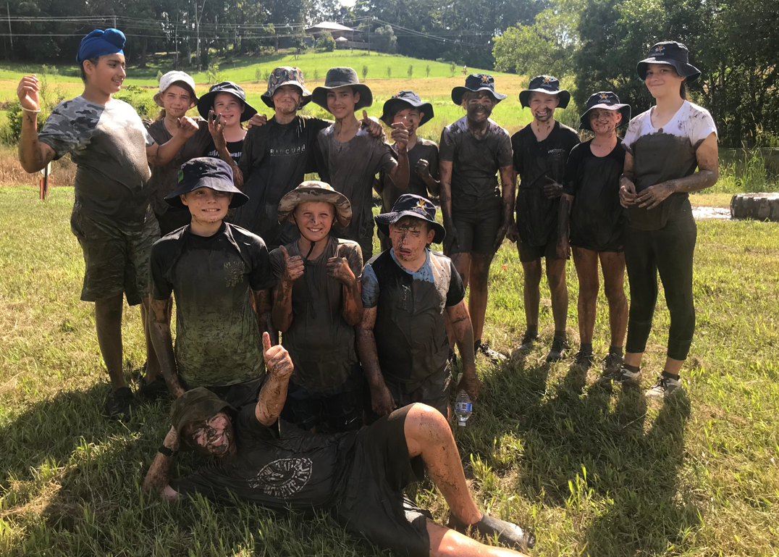
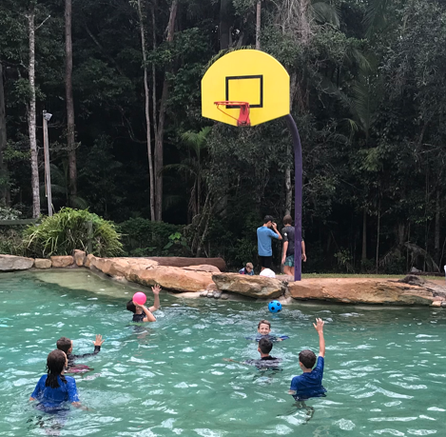
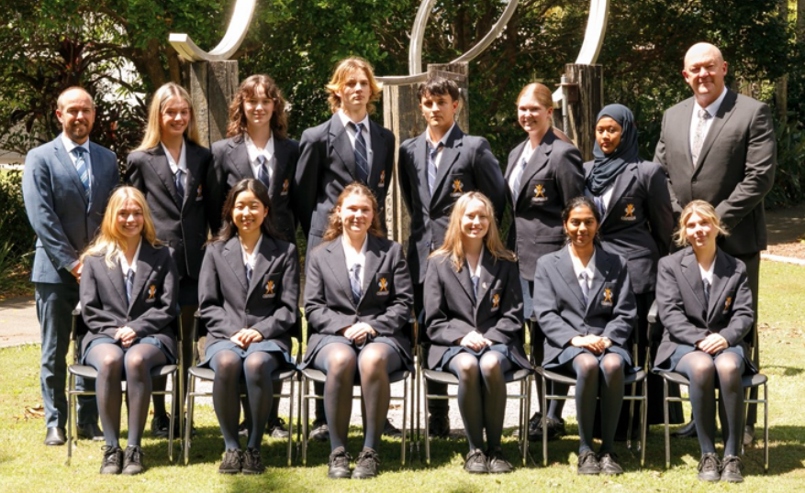
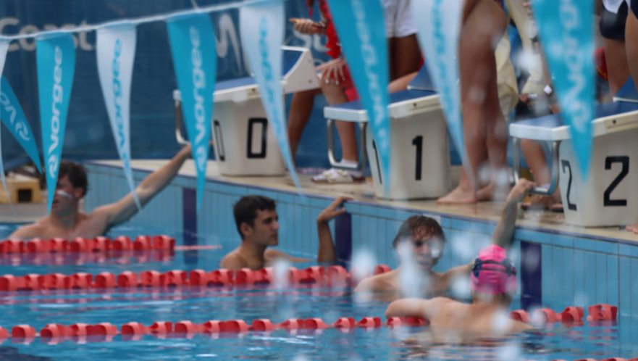
Extra Curricular opportunities
Year 7 Camp
Leadership Program – Portfolio Teams
Optiminds, Debating teams, Readers Cup
Sport
Choir and Dance groups
5C Celebration Days
Community and Special Events
Instrumental Music – Rock Band, Concert Band, Jazz Band, Woodwind Ensemble
CARE COURTESY COOPERATION CHALLENGE COMMITMENT

Slide 8



Inclusion
Notes:
Sue R

Slide 9
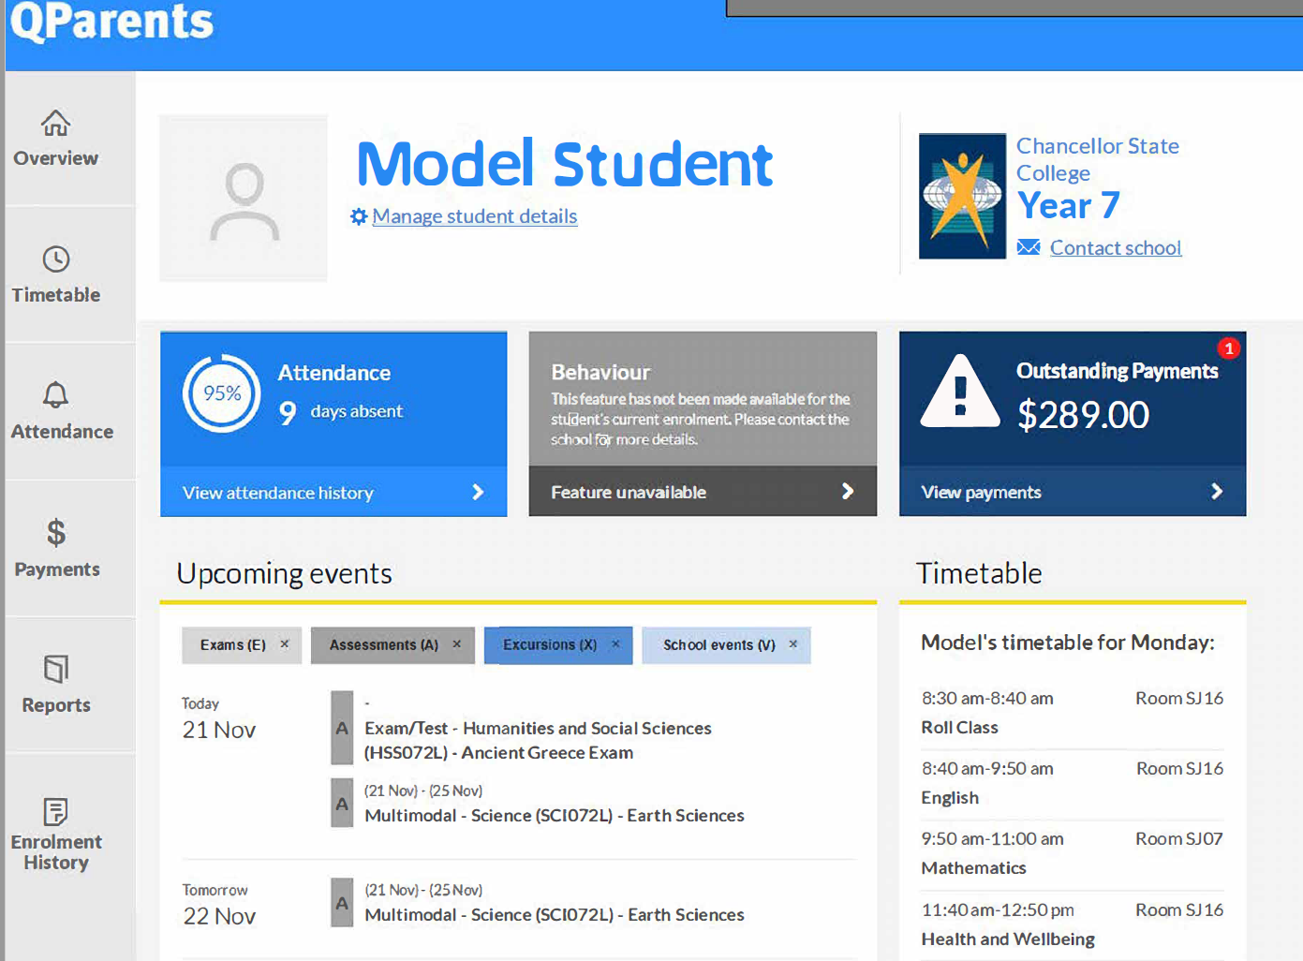
QParent
QParents is a secure, online portal that has that provides parents with 24-hour access to their child's information
QParents provides secure, online access to student information such as:
  SRS consent & invoices
  excursion management & permissions
  attendance details
  report cards,
  timetables & assessment dates
  upcoming events
  payment history
CARE COURTESY COOPERATION CHALLENGE COMMITMENT

Slide 10


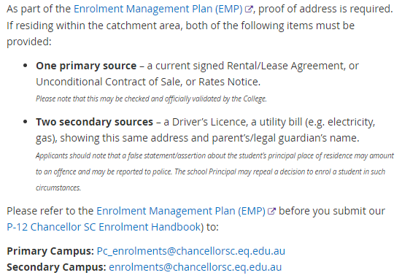
Year 7
Enrolment process
Where to from here
Complete necessary paperwork
(Continuing Enrolment or new enrolment form)
CARE COURTESY COOPERATION CHALLENGE COMMITMENT

Slide 11

Elective Subject Selection Process
Enhanced Learning Opportunities (ELO) Subject Selection Process:
Students will receive an ELO Subject Selection form as part of their enrolment package.
Existing 2026 Year 6 Chancellor State College students: return completed form via email to collegeenrolments@chancellorsc.eq.edu.au
Friday 11 September 2026.
New 2027 Year 7 students: return completed form to the Secondary Campus office by Friday 11 September 2026.
Digital copy of handbook on CSC website
CARE COURTESY COOPERATION CHALLENGE COMMITMENT

Slide 12
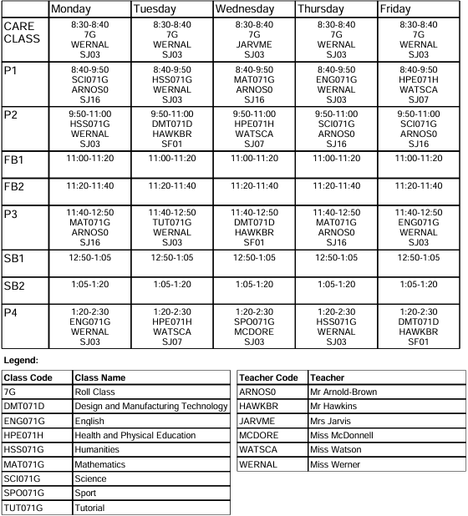
Timetable
English and Maths – 3 lessons each
Science and Humanities - 3 lessons each
Electives – 3 lessons
Japanese and HPE compulsory Electives
1 Sport, 1 Tutorial
CARE COURTESY COOPERATION CHALLENGE COMMITMENT

Slide 13
Transition Days
  All students enrolled for 2027 will attend a full day of transition
  Term 4 Week 9 –
  Wednesday 2 December – Chancellor year 6 student only
  Thursday 3 December – All student enrolled for year 7 2027
  Students will attend secondary campus for full day (8.25am – 2.30pm)
  What to bring:
  Book and pens, drink bottle, hat, lunch/money
  Please organise where and when you will collect your child at the end of the day.
CARE COURTESY COOPERATION CHALLENGE COMMITMENT

Slide 14

Booklists
Found in ‘Resource Scheme’ section of website (under Enrolments)
Can order packs or purchase from any stationery provider
CARE COURTESY COOPERATION CHALLENGE COMMITMENT

Slide 15
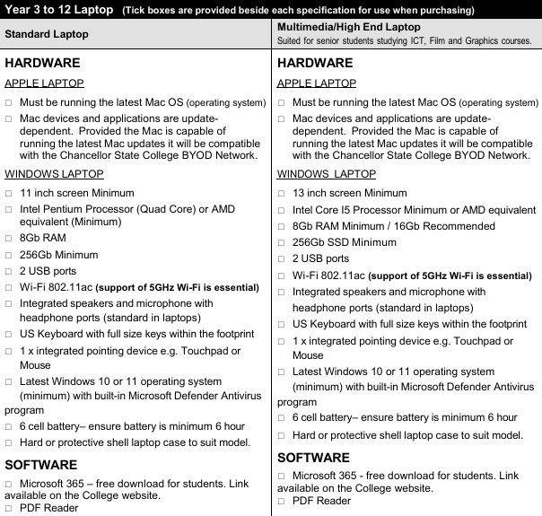
Required Resources
LAPTOP
Full charge EVERYDAY
Refer to website for laptop specifications.
Mobile Phones
Mobile phones/devices must be switched off during lesson time.
Notes:
Amy

Slide 16

Key Dates
Campus Tour Dates
Term 3
Monday 27 July 3.30pm
Thursday 13 August 9am
Term 4
Monday 19 October 3.30pm
Thursday 12 November 9
CARE COURTESY COOPERATION CHALLENGE COMMITMENT

Slide 17
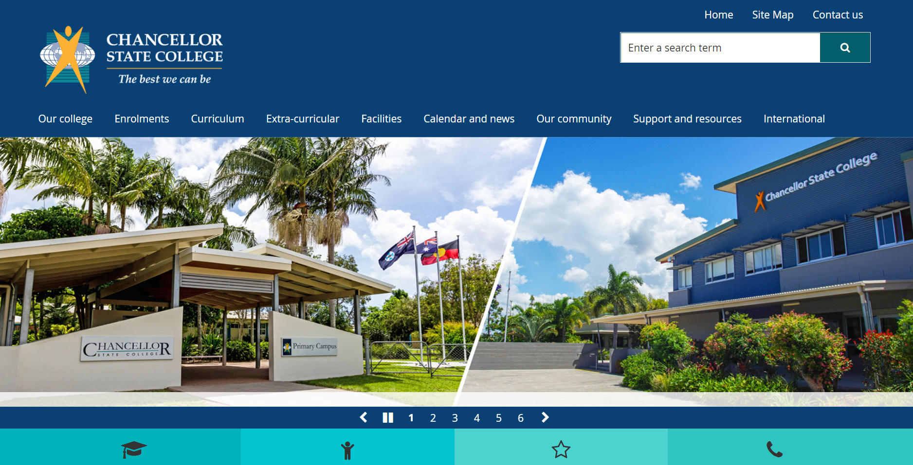
Website
Source of all information – contact details, College calendar, policies and other relevant information
CARE COURTESY COOPERATION CHALLENGE COMMITMENT

